Slide 1
Comparison of New Laws in the Global Market: Does the SVLK fit?
Rachel Butler
Independent Technical Advisor to the
European Timber Trade Federation

Slide 2
European Timber Trade Federation
Membership represents national importing federations;
  Netherlands, UK, Spain, Belgium, France, Germany, Greece, Italy, Norway & Denmark
  Additional members this year; Sweden, Finland, Austria, Luxembourg & Switzerland (importers)

Slide 3


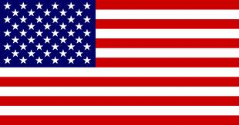
USA, Europe & Australia
Illegal Logging Laws aligning others coming on board, markets will NOT change overnight..
The liability is now on the domestic harvester or importer
Information regulations NOT documentation

Slide 4
Illegal Logging Laws:
A New Approach
Focus on legality in country of harvest
Prohibits import or selling of illegal timber/forest products
Creates obligation to question the legality of the the supply chain
Same response to all!?

Slide 5
Differences?
Border Controls
Terminology “due diligence” & “due care”
Who it applies to in US/EU/Au
Enforcement, different legal systems
Same response to all!?

Slide 6
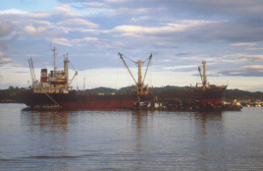
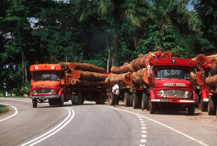
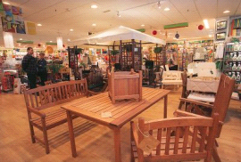
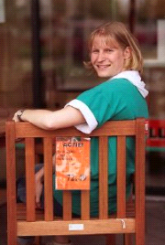
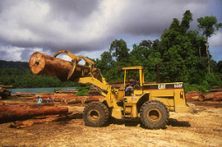
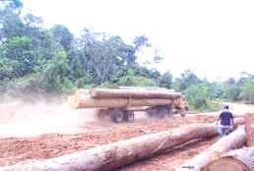
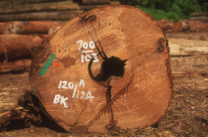
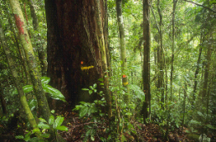
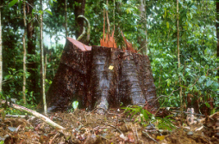
Buyers & producers need to know their supply chains
TO OPERATOR
FROM FOREST
Verification/Certification
Due Diligence/Due Care

Slide 7
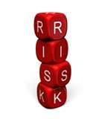
Indicators of Risk: Grey Area
Complexity of supply chains
Evidence of non-enforcement
Known cases of illegal activities
Known corruption
Lack of information about source
Lack of supply chain control
Lack of transparency
Poor quality information
Tree species

Slide 8
Implementation of Due Diligence/Care:
Lack of information on risk
Little guidance from any authorities
  Good thing; flexibility!?
Buyers need it to be simple, regulation is their issue
  Greater reliance & therefore scrutiny on certification/verification
Buyers & producers need to know their supply chains!

Slide 9
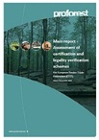
Certification & Verification
Certification and legality verification is a tool not automatic compliance; operators choice to use it & assess it.
  SVLK will be regarded as a scheme
ProForest Reports highlights the gaps in meeting legality requirements
Further issues with certification/verification not covered in the report
  Lack of info; species & source country
  Fraudulent certificates

Slide 10
Exporting to the EU: options for SVLK
NO EU BORDER CHECK
EU IMPORTER TO UNDERTAKE DUE DILIGENCE on SVLK
TRADE
DUE DILIGENCE
EU BORDER CHECK
EU IMPORTER ONLY CHECKS SVLK CERT IS VALID
GOVERNMENT
FLEGT VPA

Slide 11
Impacts so far
Markets will not change overnight
  Awareness will slowly change
Some sectors better prepared than others
More reliance on wood products manufactured & sourced from perceived low risk countries
Operators over-reacting
  Asking suppliers to sign contracts
  Asking for documentation they don’t need
Consultants not understanding the requirements
  EUTR Compliant Suppliers – do not exist!

Slide 12
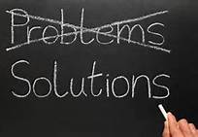
Customers want easy solutions,
Indonesia can help..
Be consistent with messages by all industry players to international market;
SVLK is your answer to international markets but
always needs credibility & transparency in implementation

Slide 13

  A new network to foster collaboration & information sharing

Slide 14
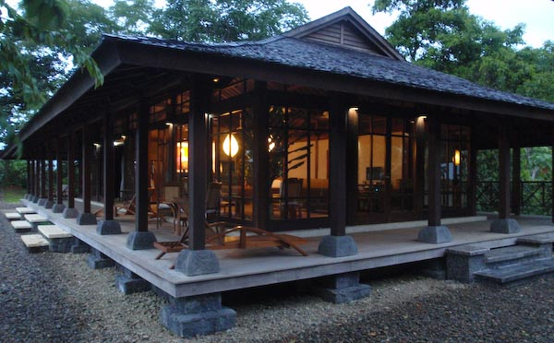
Terima Kasih
raichbutler@gmail.com

